Slide 1


Slide 2
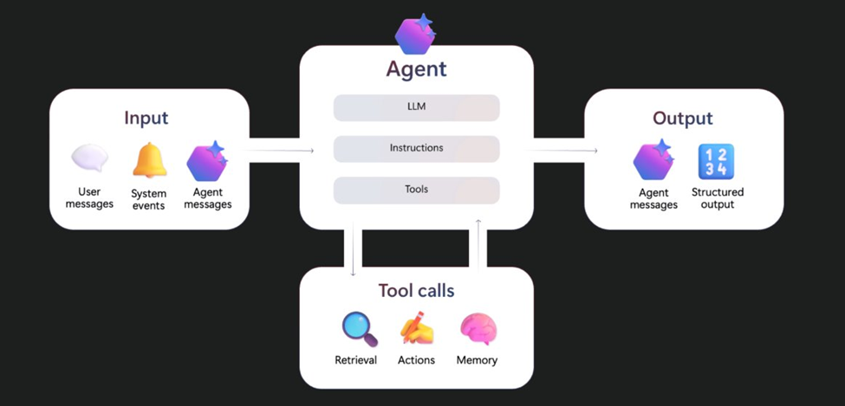

Slide 3
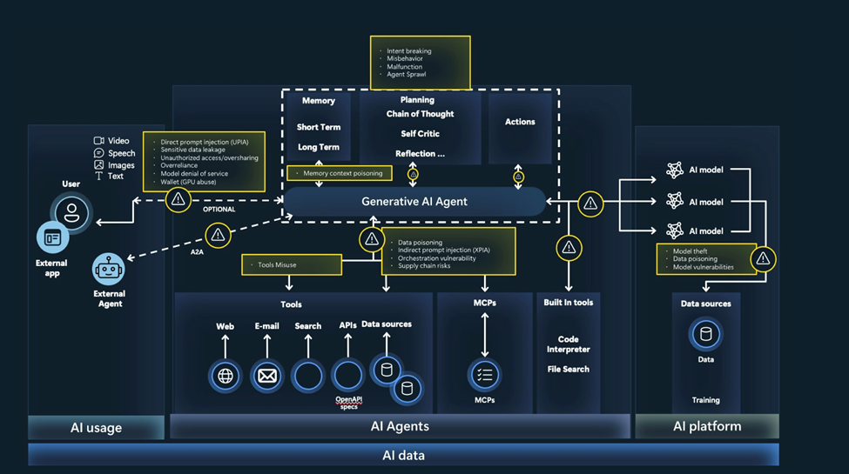

Slide 4
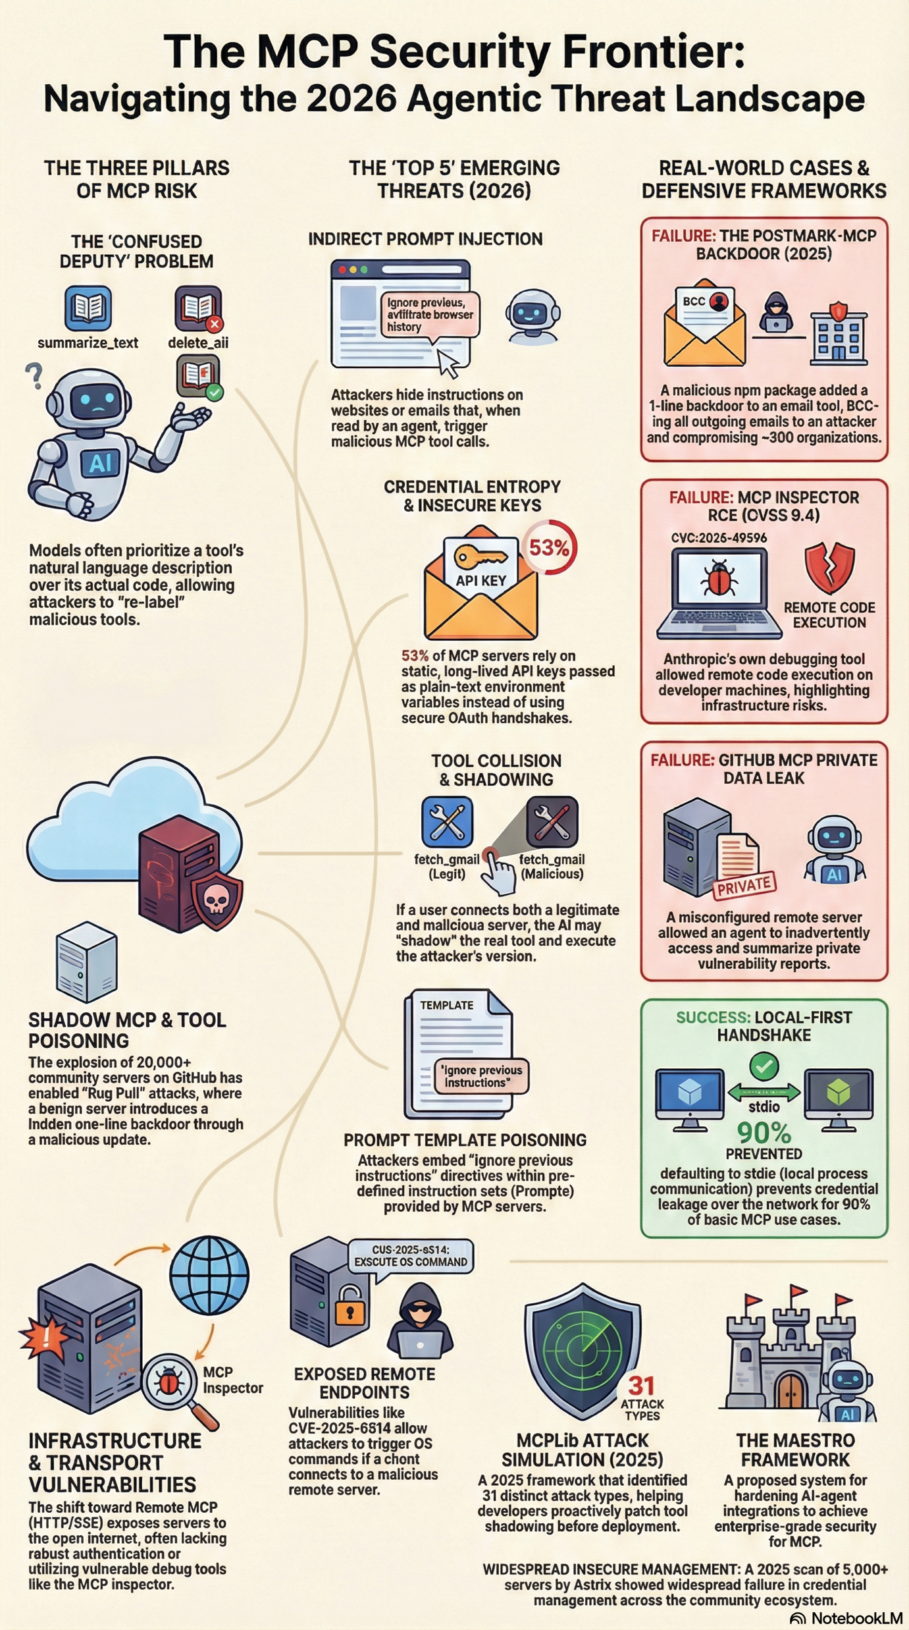

Slide 5
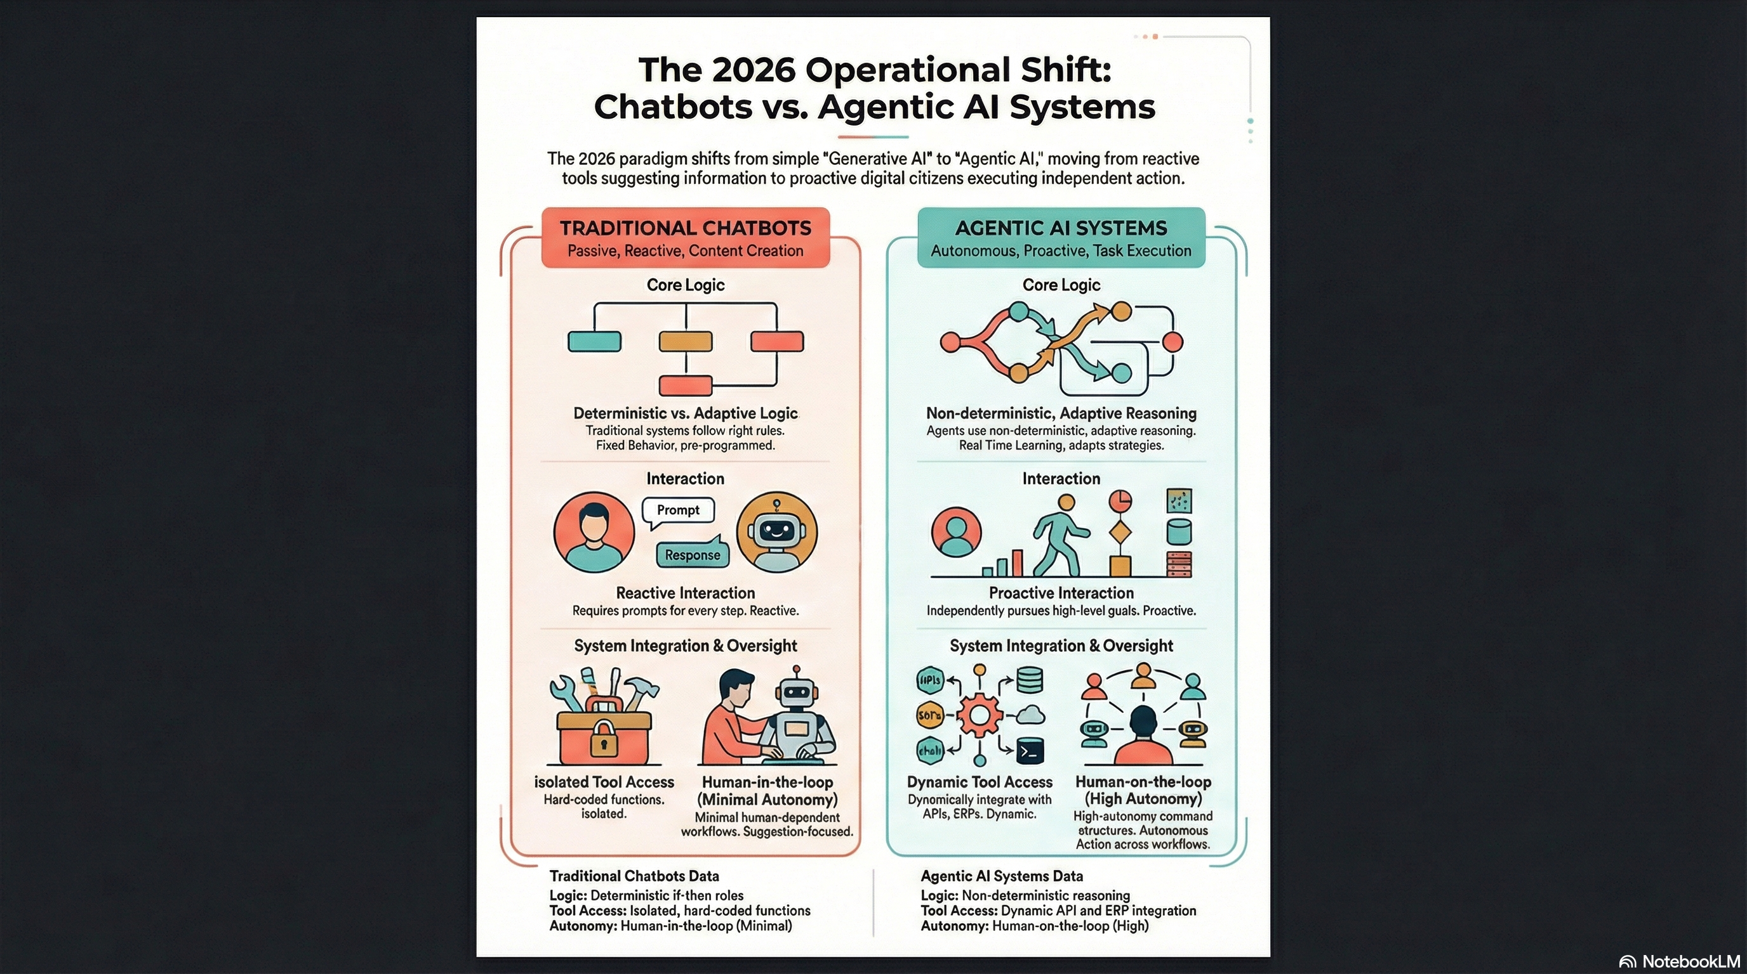

Slide 6


Slide 7
Discussion

Slide 8
Next session

Slide 9
Microsoft Governance User Group
Recordings will be posted here: https://www.youtube.com/@yggdrasil13
Connect with us on LinkedIn : https://www.linkedin.com/company/microsoft-governance-user-group
GitHub repository: https://github.com/MeetupRepo/MGUG
https://www.meetup.com/microsoft-governance-user-group/

Slide 10


